Slide 1























www.findyourmaple.tech
THE RIZE
CAREER ORIENTATION WEBSITE

Slide 3


Slide 4
About us
Team name: RIZE
Website: www.findyourmaple.tech
Our Mission: We aim to solve the problem of career orientation for high school students in Vietnam. When there is too little reliable information, too much chaos, and a lack of environment to experience, career guidance has inevitably become a concern for pupils.
Our Vision: We provide the solution of a career website with complete objective, concise, and accurate information; an exchange environment between high school and university students; and a game model that simulates future employment to help you get the clearest picture of your future major.

Slide 5
Table of Content
1
2
3
4
Market's problem
Business model and
our progress
Competitive Advantage
Risks and solutions

Slide 6
THE RIZE
1# MARKET PROBLEM
The Vietnam Chamber of Commerce and Industry reports that each year, 38% of the nation's new graduates lack a clear professional orientation, and 60% work in a different area. However, the supply of skilled workers is insufficient to meet the needs of enterprises.

Slide 7
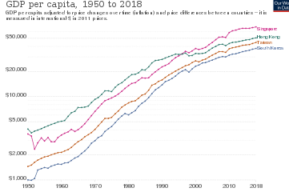
An average growth rate of more than 7%/year in golden population period of the four Asian "tigers"
mmm
Currently, Vietnam is in the golden population period with 69% of the population in working age, this period will last at least the next 20 years and this is an opportunity for business.

Slide 8
Reported Data
First-year students do not fully understand the purpose and meaning of the major
Students do not know what to do after graduation and where will recruit them
64%
50,8%
Less satisfied with the chosen profession, then they find it inappropriate
Students want to take the exam again next year...
75,6%
32,4%

Slide 9
Percentage of students who have not determined their career orientation
Nearly 50% of students when asked did not know how to choose the right major; More than 40% of students do not know what they like, what they are good at and 77% want advice on choosing a career that suits their ability.
100
75
50
25
0
Ha Noi
Ho Chi Minh
Hai Phong
Thai Binh

Slide 10

Why does this happen?
Lack self-understanding
Lack market understanding
Lack soft skills
Inaccurate information

Slide 11
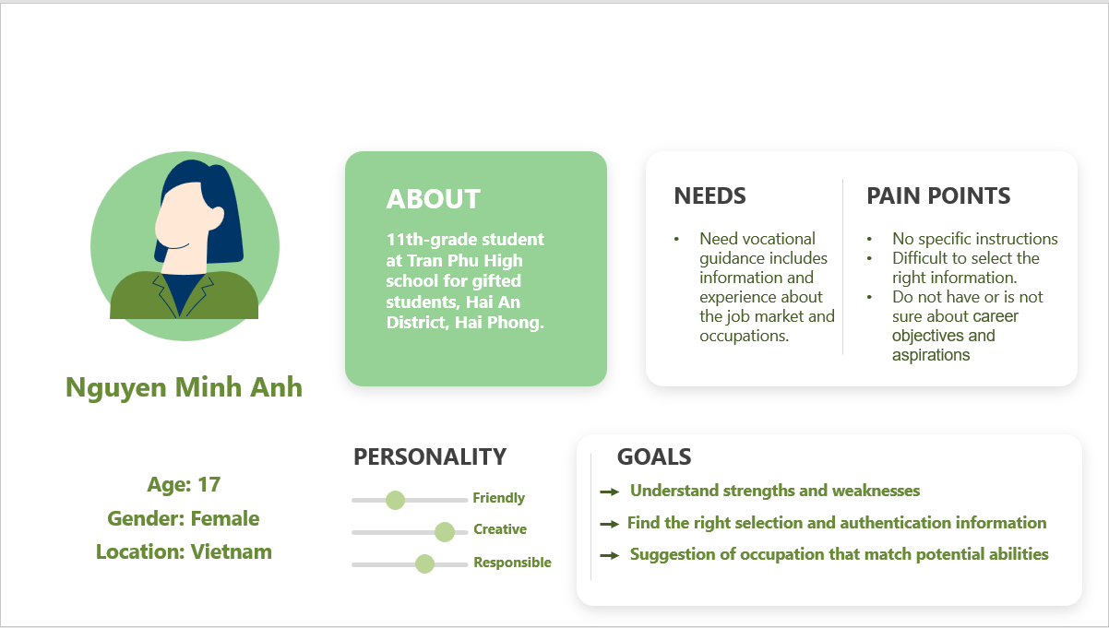
CUSTOMER PERSONA

Slide 12









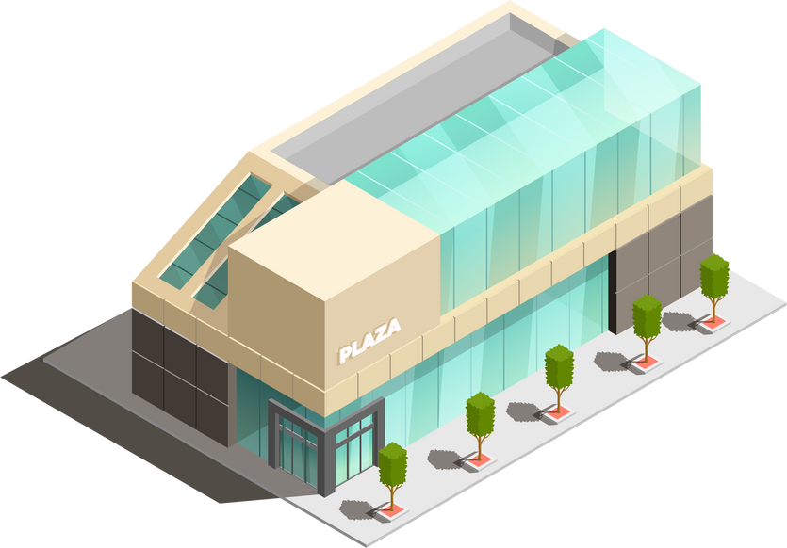





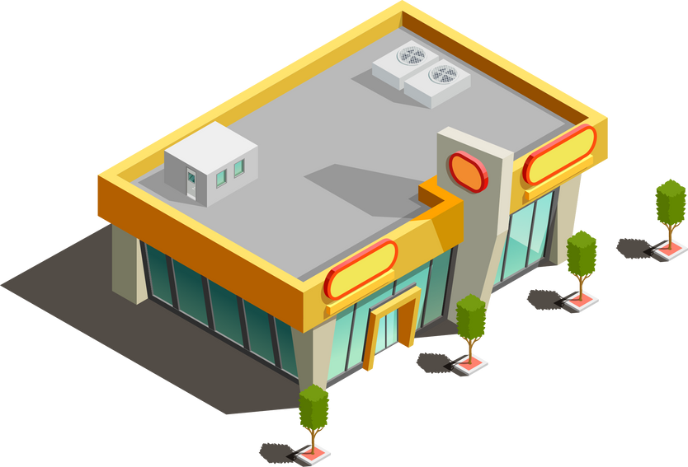


2# BUSINESS MODEL

Slide 13
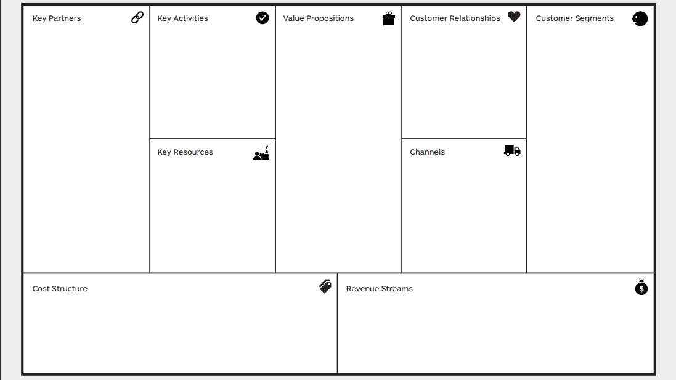
MBTI personalize results
Detailed and quality assessment of industry and university
Experiential simulation game.
1-1 mentoring
High schools
Career guidance consultants
Universities
Develope website, games, community hub.
Data analaytics
Content licensing, production and distribution
Community hub
Chat box
Feedback bar
Self service
On-demand
Students aged 14 - 22
High students
University students
Website
Platform
Content creators
IT
Word of mouth
Online advertising
Offline advertising
Social Media
Production
Research and Development
Licensing
Marketing
Payment Processing Fees
General/Admin
Premium
Advertisements
Notes:
A Customization, Accessibility, and Convenience Process

Slide 14

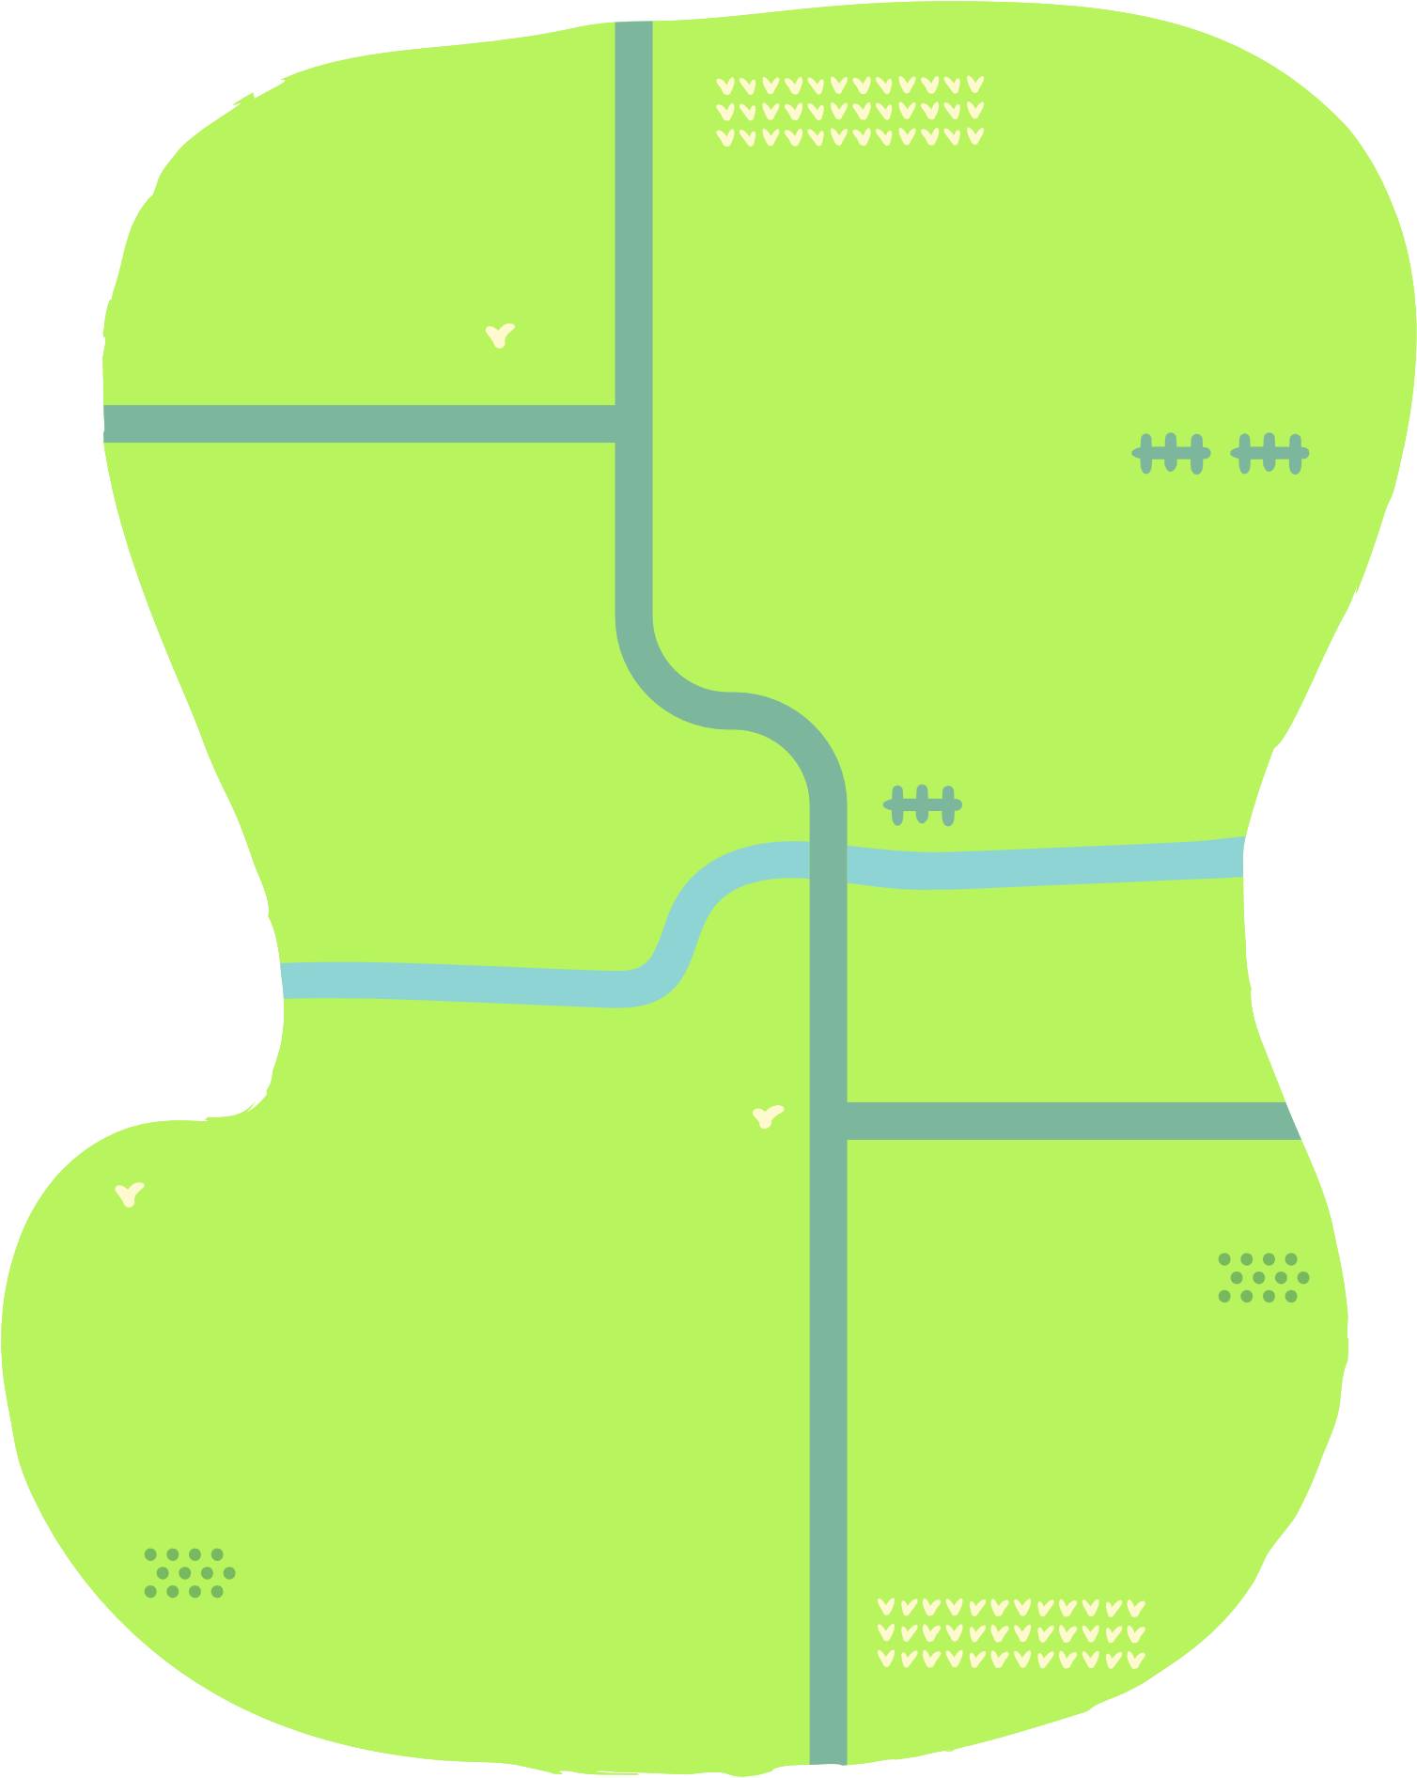








OUR PROGRESS
4
Personal mentoring
(Premium)
3
Workspace
1
2
Major and school review
1
Personality test

Slide 15







PERSONALITY TEST
The personality test is the initial element of our website. We will use the world's most well-known and reputable personality tests (MBTI, DISC, MAPP, etc.) to allow students to freely learn about their personalities in different areas of these tests. The unique feature is that after finishing all of the exams, the user will obtain the combined results of the tests mentioned above.

Slide 16
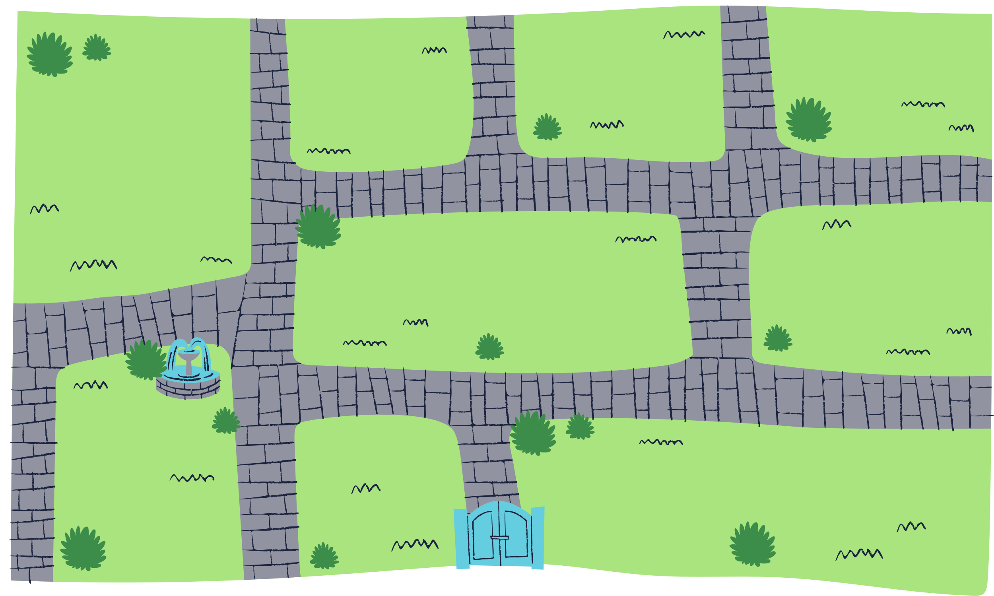















The result will be a summary of the strengths and weaknesses in each of the several areas the test examines, allowing users to fully understand the strengths and weaknesses in each several areas and fully understand themselves. For the audience of Vietnamese students, these tests will be presented in 100% Vietnamese and the result is 80% free.
MIBT TEST
BIG FIVE
PERSONALITY
TEST
DISC TEST
Notes:
To start the customer orientation process, we need to have a common understanding of the customer so the personality test is the initial element of our website. We will use the world's most well-known and reputable personality tests (MBTI, DISC, MAPP, etc.) The unique feature is that after finishing all of the exams, the user will obtain the combined results of the tests mentioned above that have customized for each individual.
allowing users to fully understand the strengths and weaknesses.

Slide 17





Y
MIBT TEST
You spend a lot of your free time exploring various random topics that pique your interest.
No
Yes

Slide 18
Y
DISC TEST

Slide 19







What kind of maple are you?
Architect
INTJ-A / INTJ-T
Human Resouces
View your maple
Finances
DISC Test
Dominant
Notes:
take the test --> have the results --> view recommendation of suitable majors --> Continue to click on the proposed major,

Slide 20

Review your school and major
The website will automatically recommend a few relevant majors depending on the user's results. Continue to click on the proposed major, and users will be given additional information about the industry, such as what sub-sectors exist, career prospects, and so on, before being referred to a few colleges that provide proper training for that industry group.
Users will be able to read trustworthy reviews from current students about the tuition fees, facilities, and training quality, giving them a realistic image of the school and their future major.

Slide 21





GROUP CHAT
Human Resouces
After finishing the test results and learning about the industry group, users may join chat groups of individuals in the same industry, exchanging information and meeting new connections.
Media and Communication
Our website will propose a few appropriate courses here so that groups of users may learn together.
Review your school and major
Human Resouces
National Economics University
University of Labour and Social Affairs (Hanoi)
Thuongmai University
University of Labour and Social Affairs
(Son Tay)
University of Industry
Hanoi University of Home Affair
Notes:
users will be given additional information about the industry before being referred to a few colleges that provide proper training for that industry group.

Slide 22

Review your school and major
Rating:
National Economics University
Architect
INTJ-A / INTJ-T
t
Users1234
Users1234
Studied the course: Human Resource Management here
Advantages: The school is quite good, convenient in terms of output, and facilities too
Points to improve: NEU has almost no minus points!
Studied the course: Human Resource Management here
Advantages: The school is quite good, convenient in terms of output, and facilities too
Points to improve: NEU has almost no minus points!
Users1234
Users1234
Studied the course: Human Resource Management here
Advantages: The school is quite good, convenient in terms of output, and facilities too
Points to improve: NEU has almost no minus points!
Studied the course: Human Resource Management here
Advantages: The school is quite good, convenient in terms of output, and facilities too
Points to improve: NEU has almost no minus points!
Notes:
Users will be able to read trustworthy reviews from current students about the tuition fees, facilities, and training quality, giving them a realistic image of the school and their future major.

Slide 23

GROUP CHAT
Human Resouces
After finishing the test results and learning about the industry group, users may join chat groups of individuals in the same industry, exchanging information and meeting new connections.
Media and Communication
Our website will propose a few appropriate courses here so that groups of users may learn together.
Notes:
After knowing their strengths and weaknesses, the suitable major and learning about the industry, users may join chat groups with a lot of people with the same interest in the same industry, exchanging information and meeting new connections to grow faster together.

Slide 24








CAREER WORKSPACE
a job-simulation game

Slide 25


We call it “Workspace” because it is a game simulation platform for users to experience the career they are interested in and directly work in a professional environment with an income burden. The game's main interface is a scaled-down metropolis, where young people's ideas and possibilities are unrestricted. Companies, corporations, and agencies from many industries are constructed in this region on a large scale.

Slide 26





Users can select a job for themselves based on their interests, whether they want to be a doctor working in a public hospital, a teacher lecturing in a specialized school, or an entrepreneur who started his own business. During your career, you will be able to perform tasks directly related to your industry, listen to advice from colleagues and superiors and have the opportunity to be promoted.

Slide 27






my maples: 10
Architect
INTJ-A / INTJ-T
Hello, welcome to our workspace!
From this moment, you have officially become a recruitment officer for company A. Here, you will be assigned tasks related to this job. You will have to complete tasks to get a chance to level up and please the difficult boss. When you complete the assigned work, your boss will reward you with a certain number of maple leaves representing the currency in this world. Be aware that if you don't complete the mission in 3 tries, you will be fined or even demoted! Good luck and enjoy the game!

Slide 28








HR CHECK LIST
The left corner on the 2nd floor is our difficult boss - the one you have to conquer. Try to overcome his difficult challenges to win the maple leaf!
Architect
INTJ-A / INTJ-T

Slide 29






CV CHECK
HR CHECK LIST
KPI: 5 person/ week
Dummy Bot 1
Job: Sophomore year student in Management Major
School: HUI
Apply for Business Administrator Position
Dummy Bot 2
Job: Junior year student in Banking and Management Major
School: NEU
Apply for Accountant Position
Architect
INTJ-A / INTJ-T
Sotfware Skills
Sotfware Skills
No
Yes
No
Yes
Abilities

Slide 30




HR CHECK LIST
YOUR MAPLE: 10
Interview potential candidates
After reviewing their CVs, you will schedule an appointment with your candidate. Note that these candidates have different personalities, please choose the right person for each position
View his CV

Slide 31






HR CHECK LIST
When doing an employee recruitment, you will have to deal with different situations using both IQ and EQ such as: internal conflicts, conflicts with customers, etc.
YOUR MAPLE: 10

Slide 32

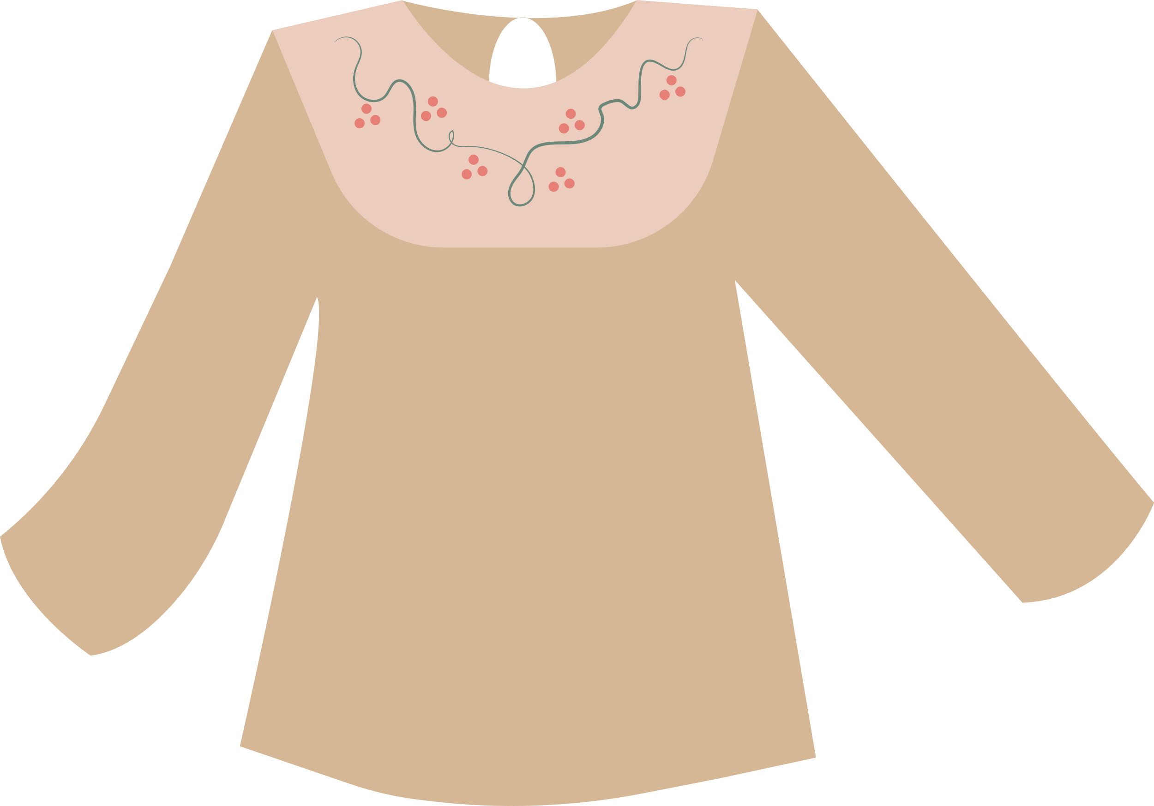



HR CHECK LIST
STORE:
25
3
20
10
4

Slide 33



HR CHECK LIST
STORE:
DAY 1
DAY 2
DAY 3
DAY 4

Slide 34

PREMIUM PACKAGE
PURCHASE NOW
Awareness Package
20% of unknown personality test results and majors and schools reviews are included
Research Package premium in-game features like speed-ups, promotion opportunities, and contests with prizes are included
Experience Pack personalized plan with a career counselor is included
Treasure Pack
a combination package includes all others with a more economic payment

Slide 35




Level of payment
14.3%
Awareness Package
28.6%
All the results of personality tests and customized recommendations
Research Package
Chance to experience all the practical and insightful mission of professions.
21.4%
Experience Pack
Opportunity to discuss with leading experts.
Treasure Pack
Experience combination of services at a more affordable price.
35.7%

Slide 36


3# COMPETITIVE
ADVANTAGES

Slide 37

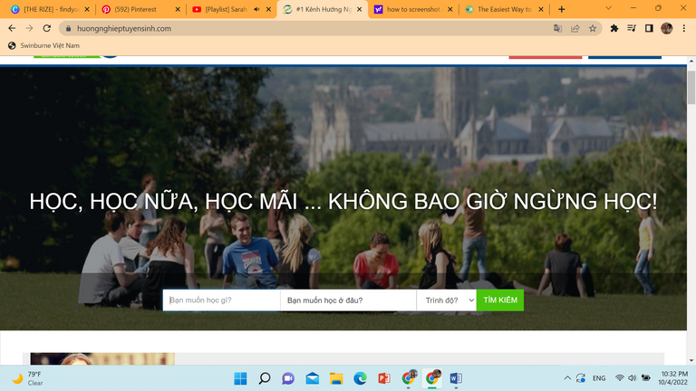
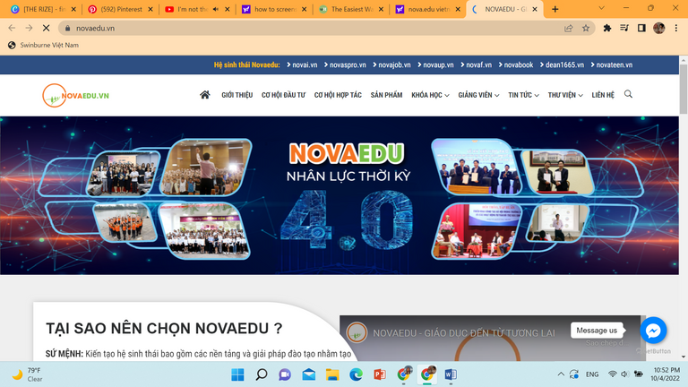
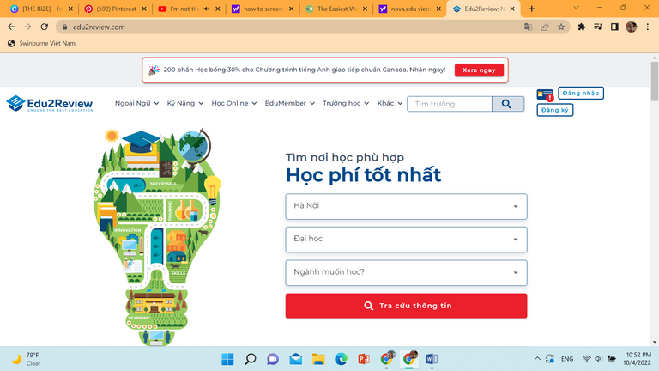
Huongnghieptuyensinh.com
Only serves as a search engine
There is only one career exam on the internet, thus there is no comprehensive, complete, and total assessment of the student's personality.
Novaedu.vn
Novaedu focuses on personality assessments to help students.
The site has not yet combined the test results into a wholly oriented version; instead, users must pay a nominal fee (20,000VND) for each test result => causes annoyed feeling from the users.
Edu2Review.com
Focus on the practicality of selecting schools and majors.
Users can browse actual reviews from students who have been and are now enrolled at the school.
Users need to have self-understanding already.

Slide 38

PROBLEM OF THESE WEBSITES
Huongnghieptuyensinh and Edu2Review, two of the most trustworthy and educational websites, are solely intended for users who are already well-versed in their interests, trends, and professions. They do not handle the first fundamental phase, which is identifying the interests and skills of the students; instead, they just offer honest evaluations from the students themselves.
Novaedu, an extensive website in cooperation with Vietnam's Ministry of Education and Training, includes a full range of personality tests, and guidance on choosing a major and school, but most of the features require a fee to experience.

Slide 39


OUR UNIQUENESS
Automatically synthesizess a variety of personality tests and synthesizes the results into one complete version
Help users understand "Who am I"
A job-simulation game
A real-life experience game providing friendly environment to play and learn
Pay in packages with low prices, therefore saving time for users
Pay per package

Slide 40



#4 RISK AND SOLUTION
Financial risk
Competitor risk
Operational risk
operational expenses
non-governmental organizations,
customer information security
human resources

Slide 41
Financial risk: Operational expenses
Problem:
The website requires funds to function: pay employees, information security system, license, website promotion,...
Solution:
Develop data and finished products that are specific to a particular career
Expand the scope gradually over time.
Operate the premium package
Apply for funding from investors

Slide 42
Competitor risk: Reputable competitor
Problem:
Several non-profit organizations are now very popular on social networking platforms.
Solution:
Providing basic knowledge and reviews about universities and majors
Creating a realistic simulation experience for users through the game.
Customized personality based on test
Personality and aptitude tests are customized for each user

Slide 43
Operational risk: Operational risks
Problem:
Personal information about customers, like name, age, exchange content, etc., can be hacked.
The project needs human resources in a variety of industries.
Solution:
Manage a team of experts to protect web security
Link with google account for information security
Contact universities to organize networking sessions
Cooperate with other career counseling companies to find consultants

Slide 44

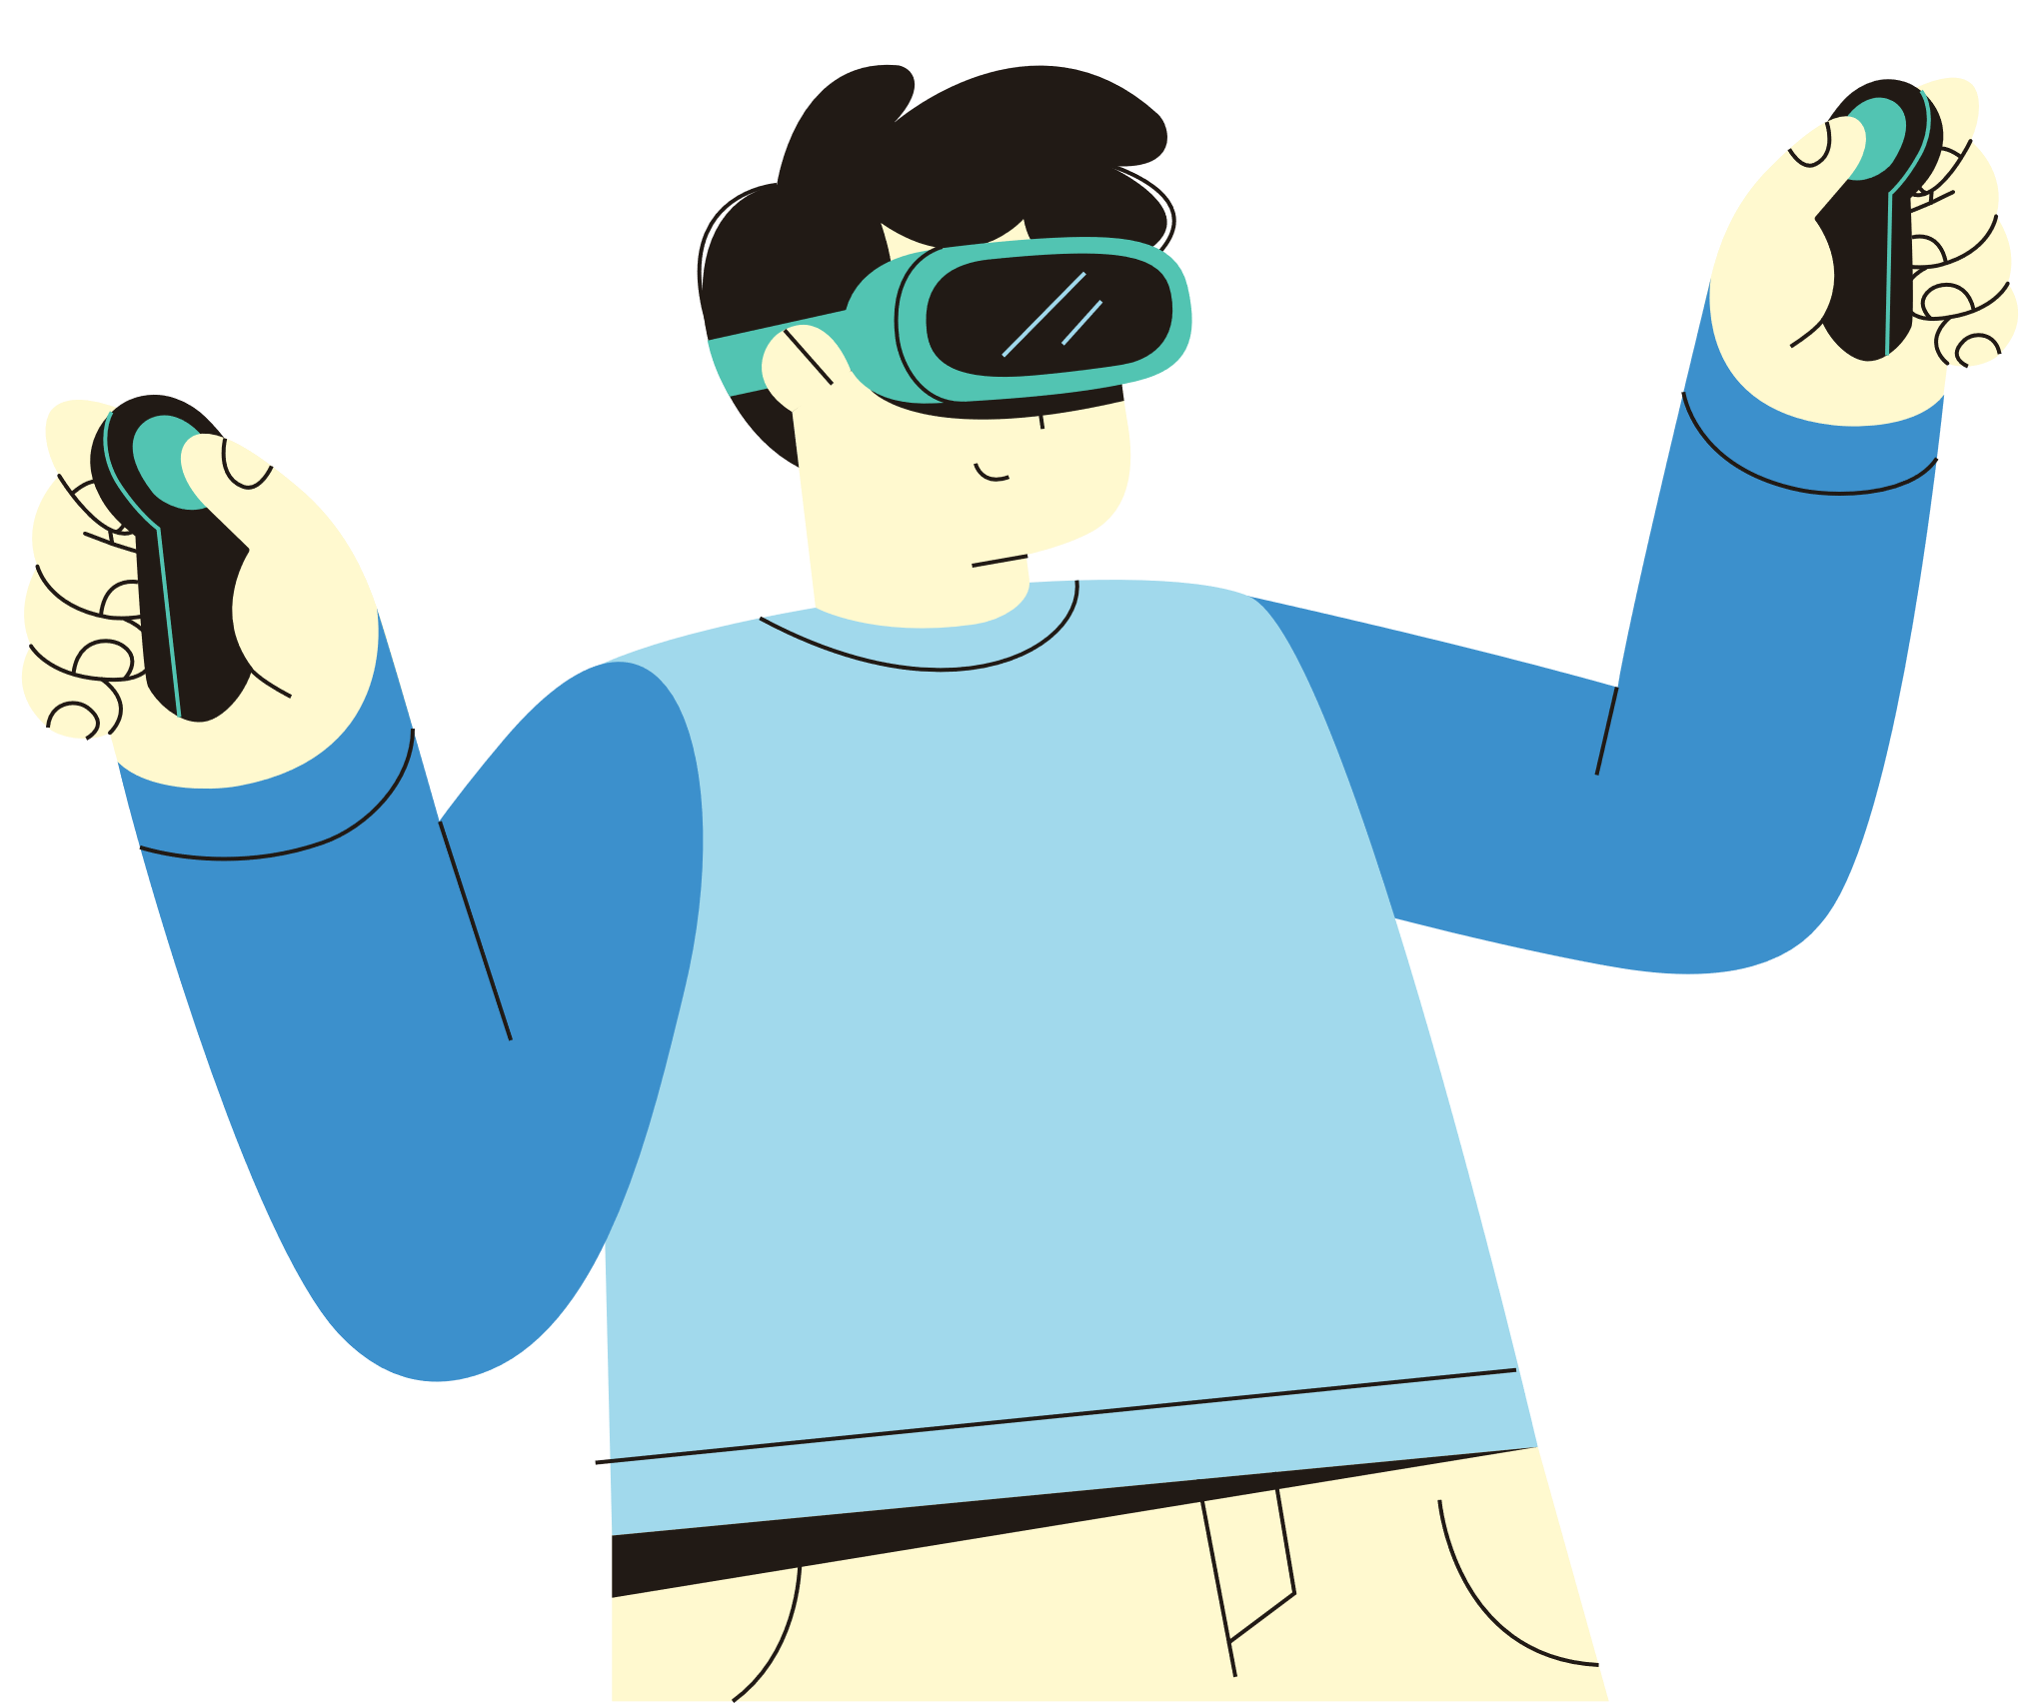
OUR PLAN IN THE FUTURE
Applying AR / VR technology through our game to bring the most realistic experience.

Slide 45
LIST OF REFERENCE
Cổng Thông tin điện tử Bộ Lao động - Thương binh & Xã hội - Hỏi đáp. 2022, Molisa.gov.vn, viewed 5 October 2022, <http://www.molisa.gov.vn/Pages/tintuc/chitiet.aspx?tintucID=18087>.
Administrator 2022, Bộ GD-ĐT: 65,4% sinh viên năm Nhất chưa hiểu hết mục đích ‘ngành học’, IUHers, viewed 5 October 2022, <https://iuhers.com/cdm/bo-gd-dt-654-sinh-vien-nam-nhat-chua-hieu-het-muc-dich-nganh-hoc.html#:~:text=Theo%20kh%E1%BA%A3o%20s%C3%A1t%20c%E1%BB%A7a%20B%E1%BB%99%20GD%26%C4%90T%2C%2065%2C4%25%20sinh,SV%20mu%E1%BB%91n%20%C4%91%C6%B0%E1%BB%A3c%20thi%20l%E1%BA%A1i%20v%C3%A0o%20n%C4%83m%20sau%E2%80%A6>.
BaoKiemToanNhaNuoc 2015, Không để học sinh không chọn nhầm ngành nghề, tránh lãng phí nguồn lực - Bao Kiem Toan, BaoKiemToan, viewed 5 October 2022, <http://baokiemtoannhanuoc.vn/trong-nuoc/khong-de-hoc-sinh-khong-chon-nham-nganh-nghe-tranh-lang-phi-nguon-luc-154158#:~:text=Theo%20%C4%91%C3%B3%2C%20g%E1%BA%A7n%2050%25%20h%E1%BB%8Dc%20sinh%20khi%20%C4%91%C6%B0%E1%BB%A3c,ngh%E1%BB%81%20nghi%E1%BB%87p%20cho%20h%E1%BB%8Dc%20sinh.%20%E1%BA%A2nh%20minh%20h%E1%BB%8Da>.
‌Boissiere, E. (2019, April 22). When You’ve Made The Wrong Career Choice. Retrieved October 26, 2022, from Forbes website: https://www.forbes.com/sites/erikaboissiere/2019/04/22/when-youve-made-the-wrong-career-choice/?sh=2cca15d97b87
Vietnam - Unemployment rate 2021 | Statista. (2021). Retrieved October 26, 2022, from Statista website: https://www.statista.com/statistics/444617/unemployment-rate-in-vietnam/
‌
‌
‌

Slide 46


THANK YOU FOR LISTENING

